Slide 1

Ragon Institute
Bioinformatics Workshops
Tuesday Meeting 7/3/18
Le Gall Lab
Ann Le, Samuel Patterson, Jiangping Li (thanks for the food today!)
Notes:
https://github.com/hmsrc/user-training/blob/master/ngs_ragon_summer2018.md
https://github.com/hmsrc/user-training

Slide 2
Intro to Next-Gen Sequencing
Perform computationally-heavy work in interactive sessions, not login mode
Submit jobs to SLURM, the cluster scheduler
Jobs submitted with sbatch and requires -p (partition) and -t (time wall)
Lists all running/pending jobs using $O2squeue
Using an sFTP (secure file transfer protocol) like FileZilla or WinSCP is helpful to view file manipulations and transfer files from your computer to another server

Slide 3
In-Class Tutorial Summary
Given small mouse dataset of multiple .fastq files to run a quality control via FastQC to identify problems with quality of reads, identify adapter sequences, kmers, etc. and create .html files
Aggregate reports with MultiQC
Aligned .html files to NCBI genome with STAR alignment which creates .bam files
Manipulate .bam files using Samtools

Slide 4
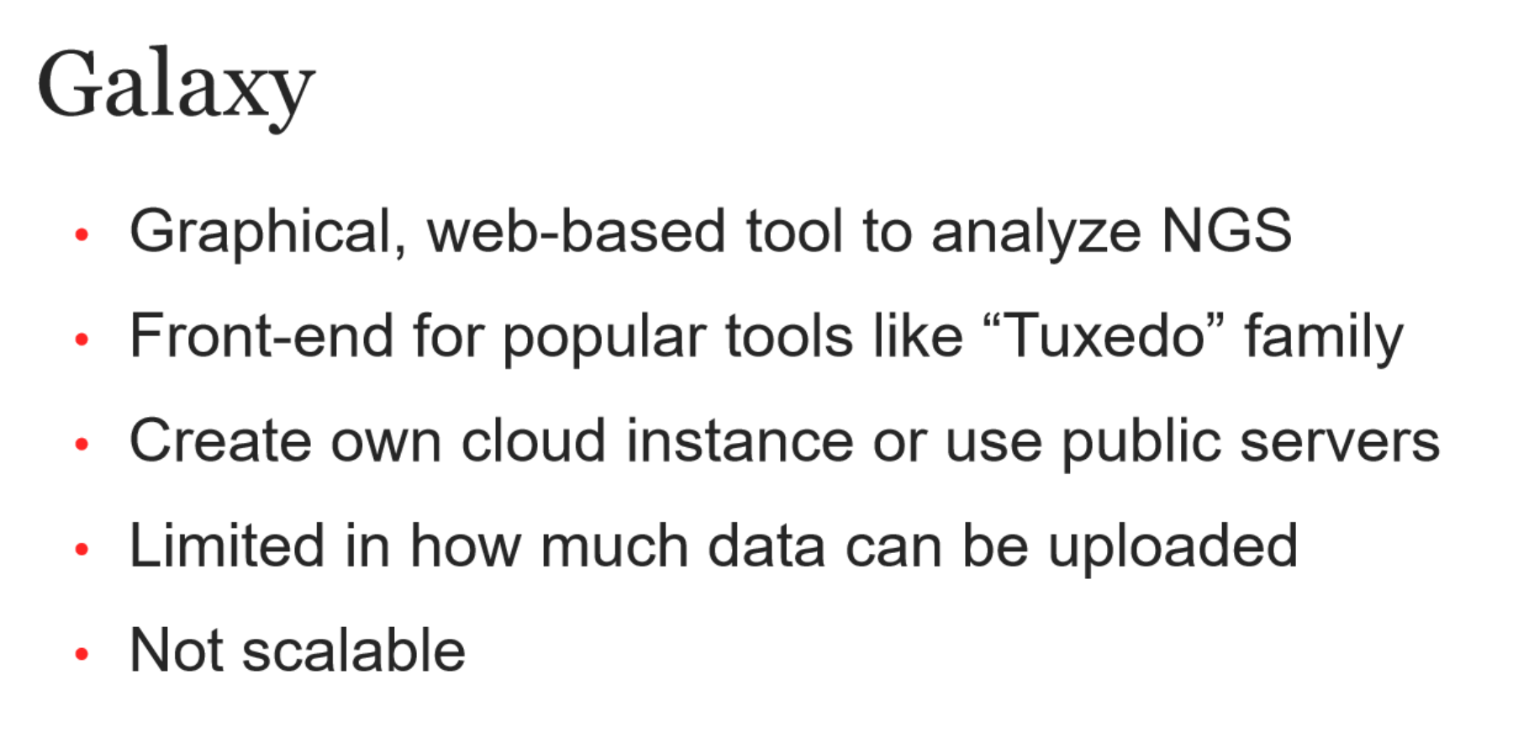

Slide 5
Bowtie 2 -- RNA fasta to bam/sam genome mapping
Bowtie aligns NGS reads to a reference genome -- many reference genome indices are available for download (Human, mouse, HIV) but can also be generated locally if needed
Very memory intensive -- best ran on O2 for anything beyond test cases
Output is a bam/sam file. Bam are binary for computer use and are much smaller. .sam files are human readable but huge and much slower to work with
Lots of memory required, included in Galaxy but limited by file and memory limits

Slide 6
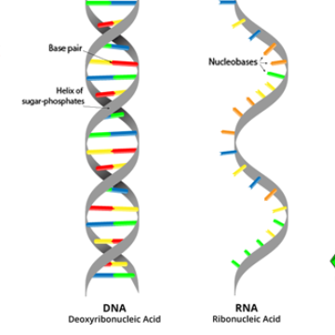
customProDB -- sam/bam/vcf to fasta MS database
Very popular R package for custom MS database creation
Takes bam/sam/vcf files and uses a reference genome
Included in Galaxy, but also available on O2 (pending…)
https://www.ncbi.nlm.nih.gov/pubmed/24058055
Another new package in the wild west of proteogenomics is PGA -- can be run without reference genome data

Slide 7
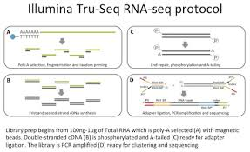
Further Reference
https://github.com/hmsrc/user-training/blob/master/ngs_ragon_summer2018.md

